Slide 1
Programming & System Development (M)
September 2024
Dr. Mireilla Bikanga Ada
Dr. Kevin Bryson
Dr. Mary Ellen Foster
© 2008 David A Watt, University of Glasgow

Slide 2
Aims
To enhance existing skills and practical processes for programming in Java and Python, which are the main languages used in the MSc programme
To improve skill at using online information to pick up new languages, APIs or tools
To become familiar with common tools needed to build working systems, including repositories, virtual machines and servers.
To develop knowledge of the use of the LINUX operating system and experience of using the tools available under LINUX for programming and system administration.

Slide 3
Learning Outcomes
1. Demonstrate familiarity with the relevant modern programming environments;
2. Use the command line and a text editor competently, ideally with experience with a modern IDE;
3. Develop well-structured programs in Java and Python, and be proficient in looking for online help, and be prepared to pick up new skills independently;
4. Explain the importance of concise and informative documentation, and use modern documentation tools;
5. Provide evidence of program correctness through thorough testing;

Slide 4
Learning Outcomes
6. Describe and use version control processes, and be able to checkout and use a repository (e.g. git);
7. Launch, edit and use Jupyter/Colab notebooks (including ability to work with basic operations on numpy arrays);
8. Use basic SQL from Java and Python, and be able to set up a basic server;
9. Be able to spin up a Container (e.g. Docker VM (and/or Kubernetes));
10. Creating/adapting a basic graphical user interface (give them some exposure to a modern GUI and how to adapt it);
11. Describe the basics of user interaction with the Linux shell, file navigation, system monitoring, printing;
12. Explain how to install and configure software under Linux, and be able to write and execute simple Linux shell scripts.

Slide 5
Lectures’ contents
Introduction
Python Basics, Decision Making & Object-Oriented Programming (OOP) in Python, Git, Conda, Google Colab
Python – Repetition, functions, Variable management, Data structures
Python – Files & Exception, SQLite3
Data Processing – Pandas , Numpy, Pytorch
Data Visualization - Matplotlib
Java
Java
Java
Unix - Linux shell, file navigation, system monitoring, printing
Unix - Install and configure software under Linux, and write and execute simple Linux shell scripts
Revision

Slide 6
What changes have we made to the Course?
Removal of Tkinter
Update the material to include Conda, Google Colab and PyTorch

Slide 7
Assessments
Tutorial exercises
Sample solutions available.
Participation to peer review (tAPP): weighting 0.05 (5%)
Group Project: weighting 0.25 (25%) Deadline: 02/11/2024 at 4:30 PM
Assessed Exercise. Broken down into 4 exercises
Assessed Exercise 1 (5%) Date: 04/10/2024
Assessed Exercise 2 (10%) Date: 11/10/2024
Assessed Exercise 3 (10%) Date: 25/10/2024
Assessed Exercise 4 (5%) - Date: 22/10/2024 Deadline: 29 October 2024
total weight = 0.3 (30%)
Lab Exam – Date: December during exam period– On campus and invigilated
weighting 0.4. (40%)

Slide 8
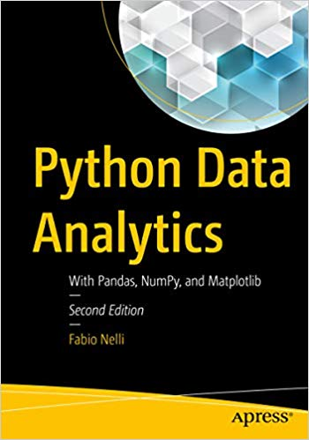
Reading (1)
Fabio Nelli Python Data Analytics Apress (2018)

Slide 9
Reading (2)
http://www.dcs.gla.ac.uk/bootcamp/
Username “student”
Password “Letmein”

Slide 10
Modified Team-Based Learning Approach
Pre-Lecture material
Read the material before coming to the lecture
Take the quiz or any test
Lecture Material – Problem Solving Tasks (1 hour per session)
You are given some problems to solve based on what you have read
Try to solve the problems alone first
Then discuss with your team members.
Produce a solution as a team
Give your solution to another team for peer – evaluation
Tutorial/Labs (2 hour per session)
Support each other.

Slide 11
Other Things to know
Tutorials/Labs: released at least a week before to give you the chance to attempt before the next class. Solutions some time after!
Always have the following items with you in lectures:
Paper
Pen/pencil

Slide 12
Important note about lab groups and project teams
Each student is a member of one team (listed on Moodle)
All team members will be in the same lecture section and the same lab section
Students within the same team:
May support each other during the labs
Work together on a Team project
Participate in the group peer review of team Application exercises (tAPP)

Slide 13
What type of feedback do students receive?
We give feedback in many forms that go well beyond coursework grades.
Group discussions, 1-1 help from GTAs and demonstrators in the labs, lectures or tutorials where solutions or common issues are discussed.

Slide 14
Any Questions?

